Slide 1
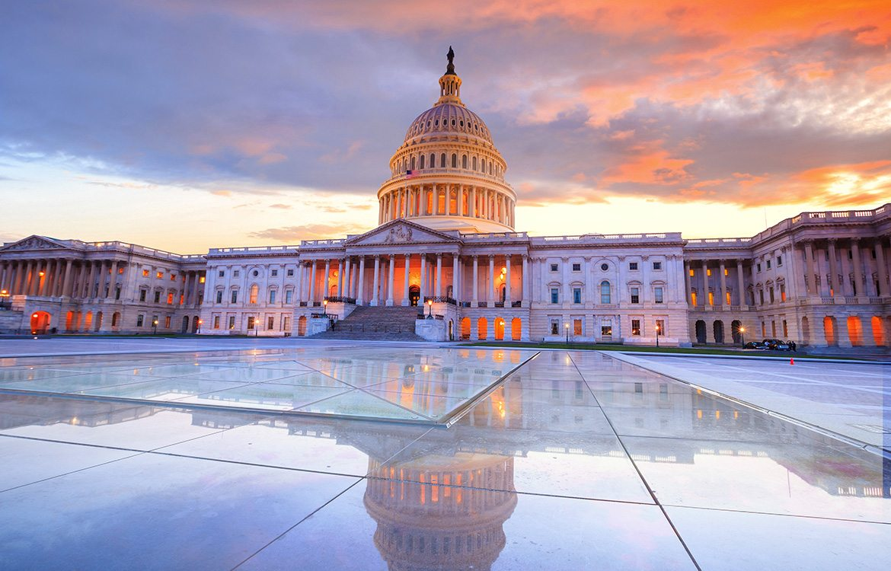
Capital Bikeshare
Capital Bikeshare
Diana Jaffé
Feb. 9th, .2021
1

Slide 2
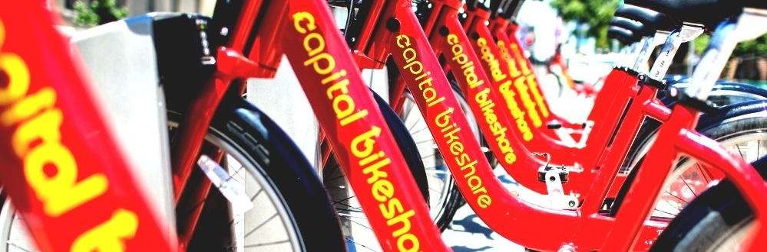

„It‘s The Customer, Stupid!“
How to Provide Maximum Comfort and Service to Capital Bikeshare‘s Users.

Slide 3
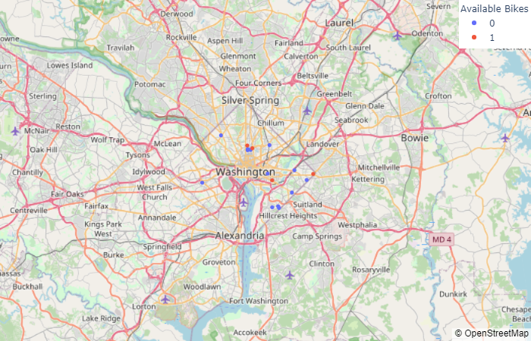

Real Time Data: Availability Of Bikes

Slide 4
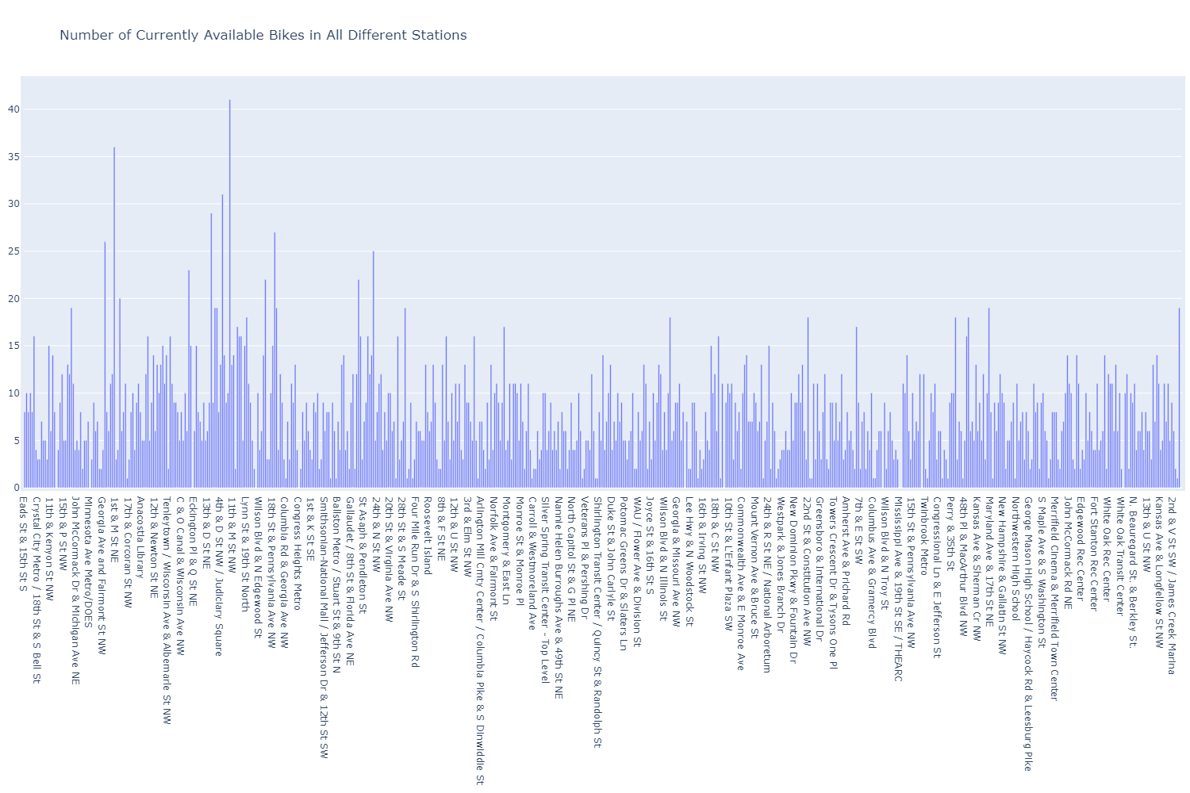
Real Time Data: Availability Of Bikes

Slide 5
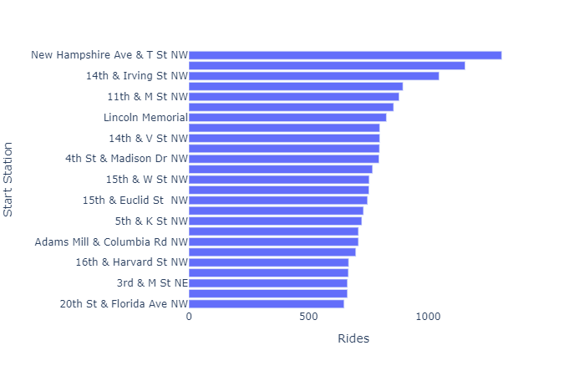
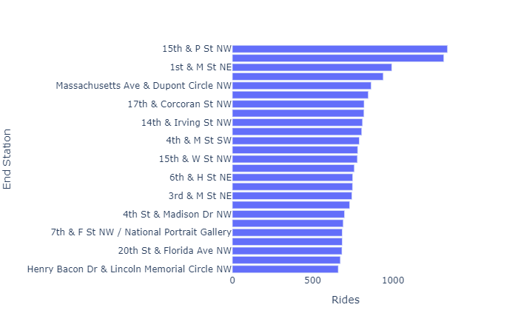
Top Start Stations And Top End Stations (Dec. 2020)

Slide 6
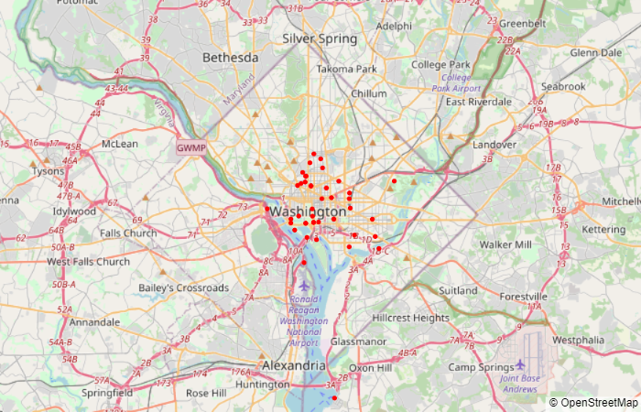
Top 50 Circle Rides (Dec. 2020)

Slide 7

Predicting The Future In Times Of Corona
Calculating 2021 from 2019 and 2020

Slide 8
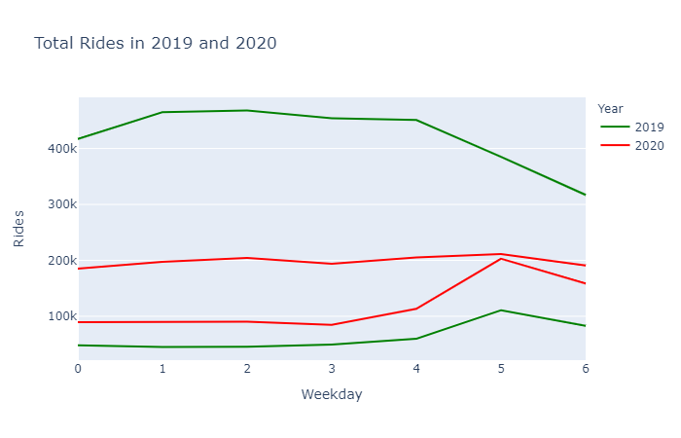
The Future Is A Matter Of Perspective: Data Basis

Slide 9
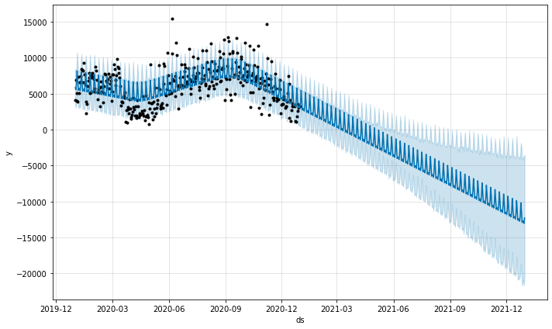
The Future Is A Matter Of Perspective: 2020 Only

Slide 10
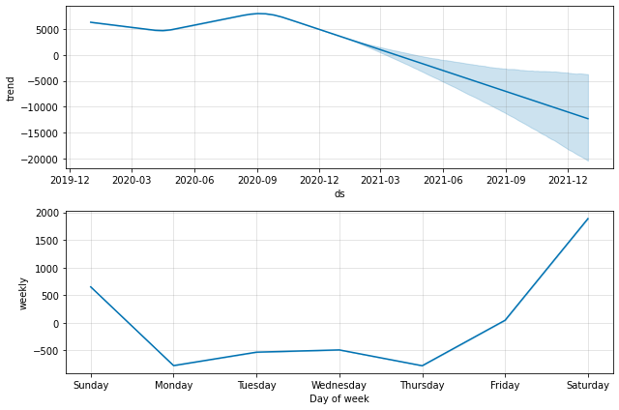
The Future Is A Matter Of Perspective: 2020 Only

Slide 11
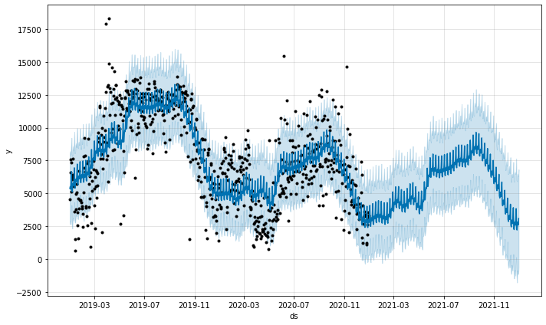
The Future Is A Matter Of Perspective: 2019 + 2020

Slide 12
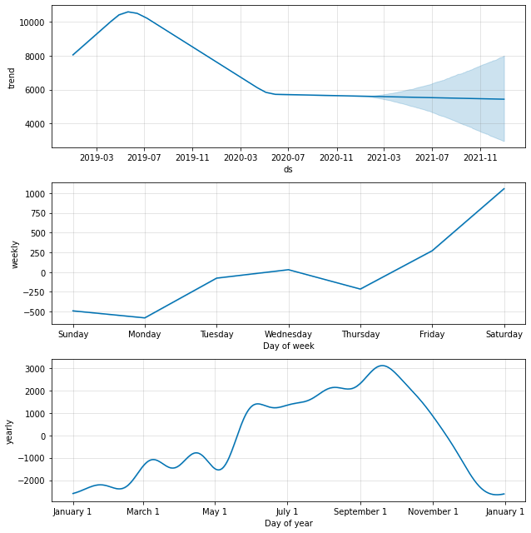
The Future Is A Matter Of Perspective: 2019 + 2020

Slide 13
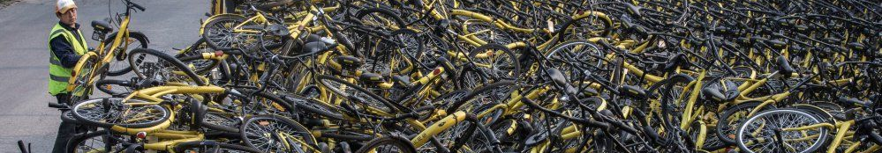
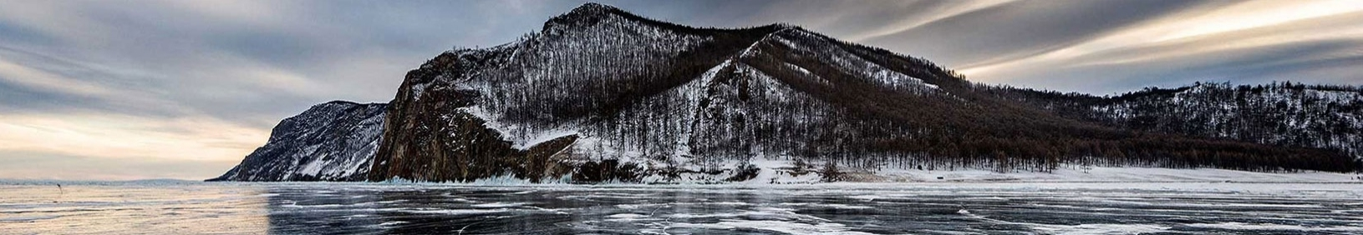
KPI Recommendations: Bike Availability
Make it easy to get bike
Make it easy to return bike
Adapt price model to rides
Optimize availability of bikes when and where they are needed.
Improve availability of intact and free docking stations for bike return. Most people rent bikes with certain plans.
They do not want or cannot afford spending additional time to search for free bike docks.
Ride duration clusters and averages give you perfect hints for pricing models in favor of your customers and the company.

Slide 14
Further Recommendations: User Experience
Improve app quality: Many users experience serious problems with non-working apps while having payed for renting.
Some customers of daily passes don‘t get the information about maximum renting time of 30 min. and are shocked to get high bills. Many of these customers share their bad experiences with capital bikeshare publicly. → Either change renting options, → offer additional renting models → or communicate renting rules more visibly.

Slide 15
KPI Are Just Pointers To Really Important Questions
How many members leave Capital Bikeshare for good? WHY?
Instead of counting the number of complaints: WHY are customers unhappy and what can we do about it?
What – and who – is our untapped market potential?
Who were the members of 2019 – but not in 2020 anymore?
How can we provide bike riding as the healthiest kind of every day transportation in town – especially during Corona times?
How can we provide bike riding to those who have lost their jobs and cannot afford our regular tariffs (while rides are still low)?
How can we help our fellow citizen to stay healthy overall?

Slide 16
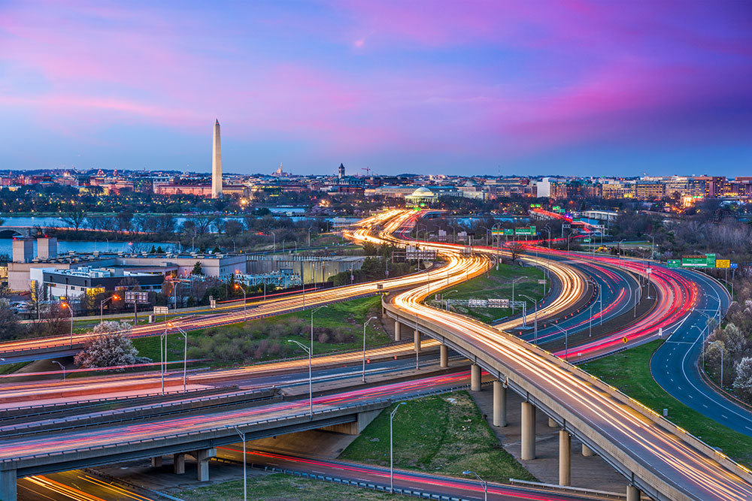
Thank you!

